Slide 1
H.263 Media Compression Broadcast on FPGAs Mid-project Demo
Team 4 (Justin Hai, Yufeng Zhou, Isamu Poy)
Notes:
isamu

Slide 2


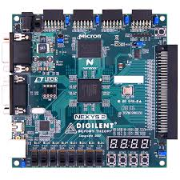
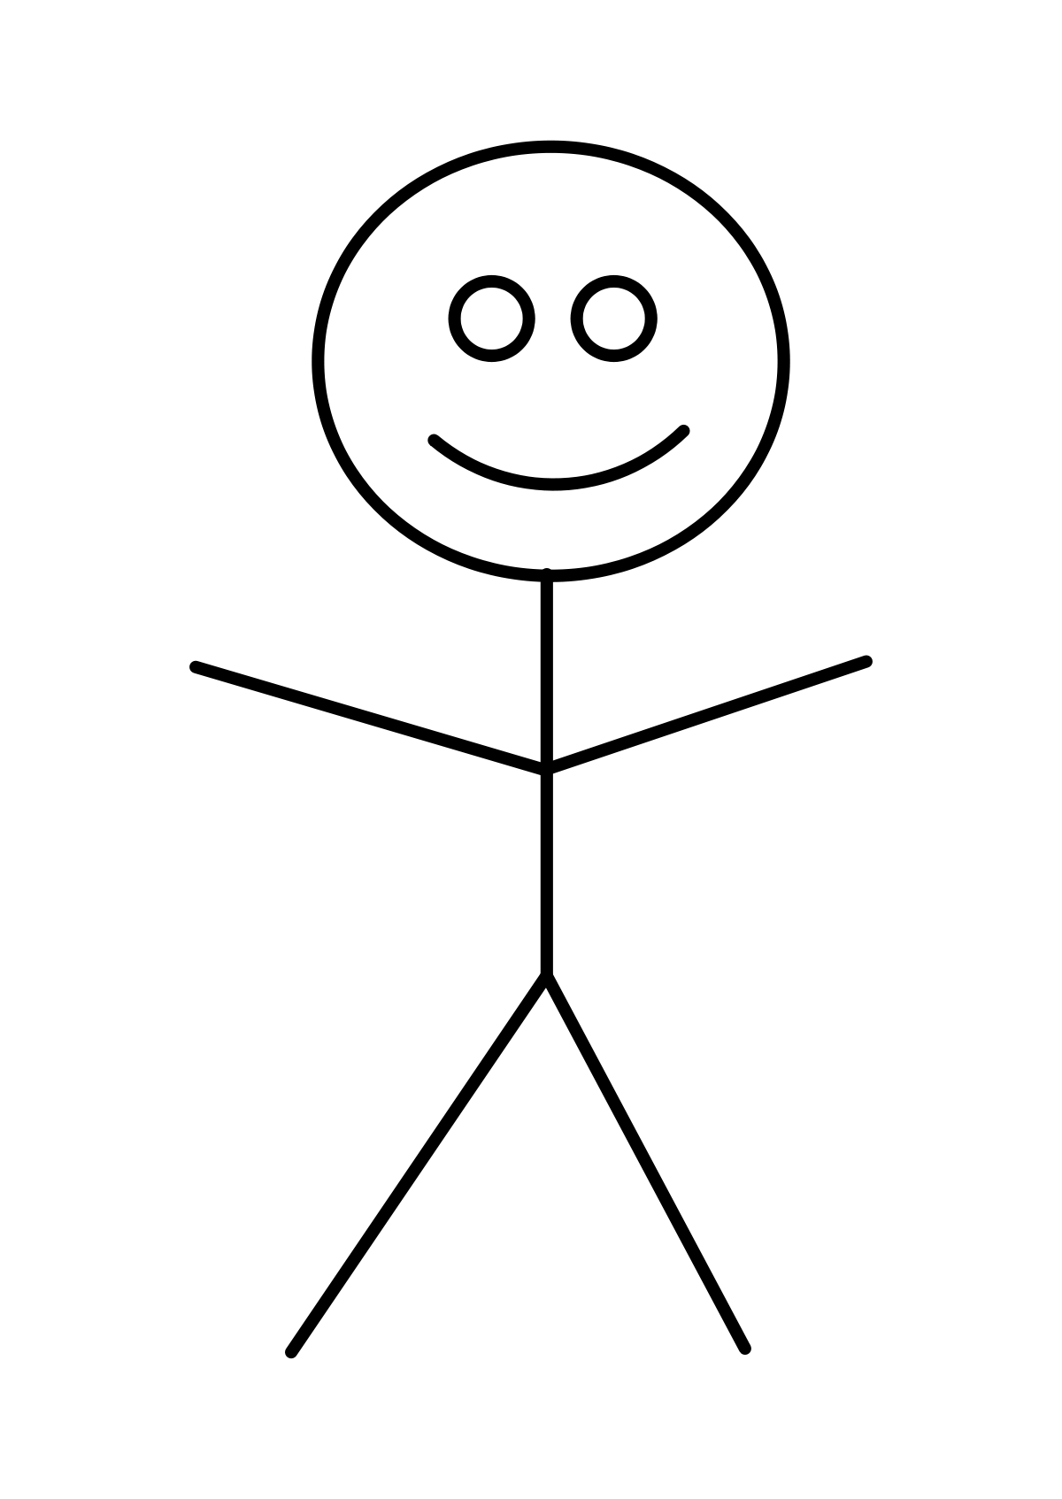
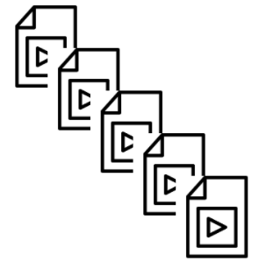

Project overview
Notes:
With the COVID-19 pandemic, remote work has made video broadcasting more important than ever. However, video compression algorithms can be very complicated, we hope to create an FPGA video compressor which will allow current university students to share their videos in real time over a limited bandwidth connection using the h.263 algorithms

Slide 3
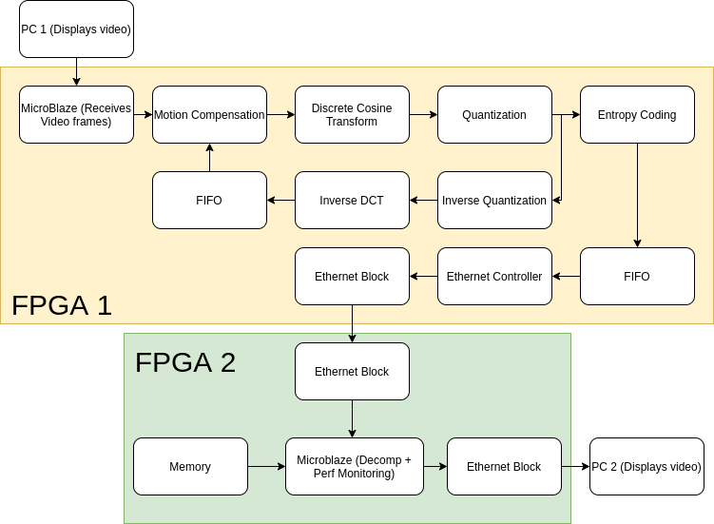
System Block Diagram
Notes:
To recap, this is the system that we are trying to develop. So far we have most of the modules in software which are currently being developed into hardware cores

Slide 4
Major Changes

Slide 5
Major Changes - DCT
Notes:
justin

Slide 6
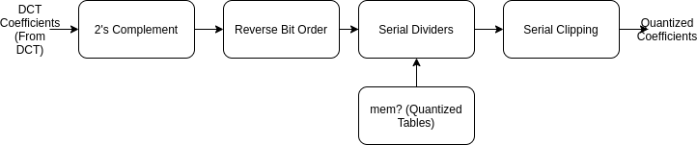
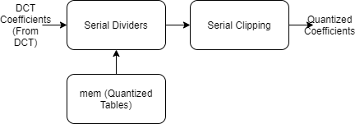
Major Changes - Quantizer
Notes:
justin

Slide 7
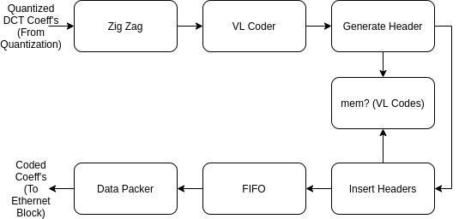
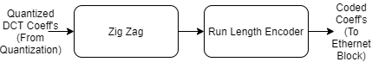
Major Changes - Encoder
Notes:
justin

Slide 8
Major Changes - Other
Switched to Fixed Point Arithmetic rather than Floats
Switched to using TEMAC adapter rather than Ethernet Lite
Utilize DDR memory on microblaze
Notes:
justin

Slide 9
Challenges
Hard to understand the TEMAC manual (263 pages) -> Use provided example design to help understanding TEMAC
Implementation of cores unclear -> Found reference designs online
Reference designs unintuitive -> Write/draw test cases on paper
Debugging segfaults in the software implementation -> Use GDB for debugging
Debugging odd behaviour in embedded programming -> Get software working 100% correctly and compare outputs
Limited time -> Build functional cores first, then improve performance
Limited on-chip area -> Refactor implementations, reducing parallelism
Notes:
We first write our individual challenges and then reformat it to make it not look individual (BOB)

Slide 10
Demo Recap

Slide 11
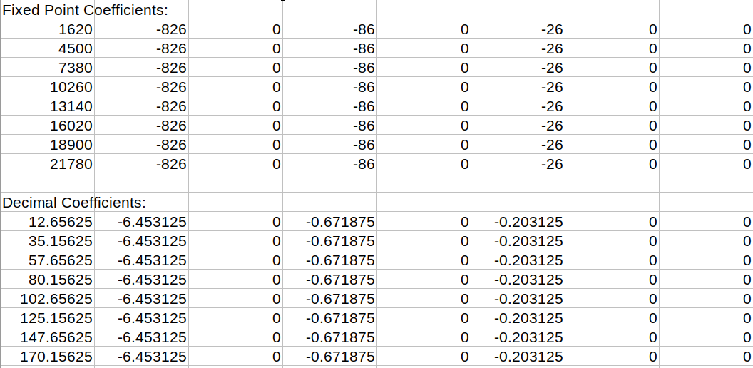
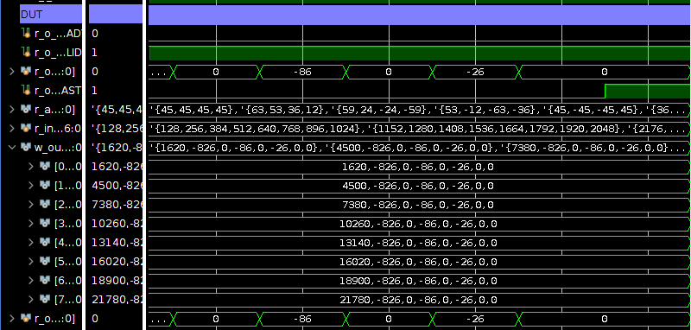
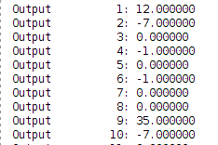
Demo - Compression Algorithm Simulation
Notes:
Justin

Slide 12
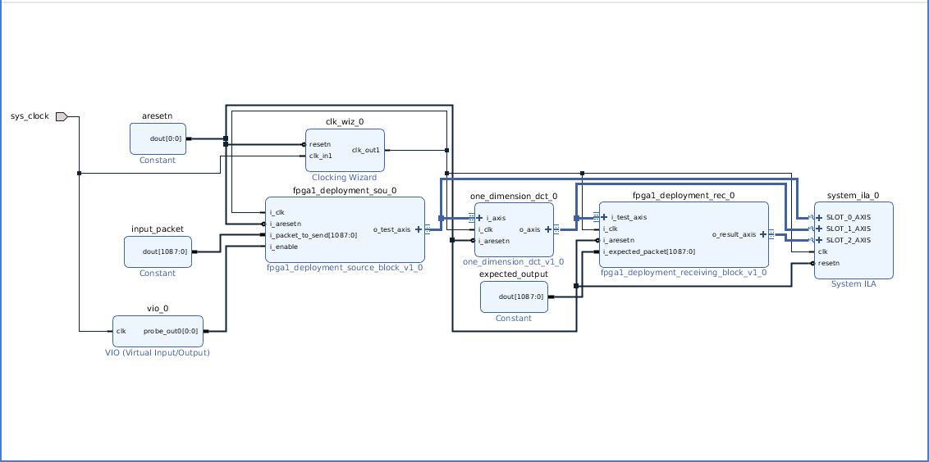
Demo - Compression Algorithm Deployment
Notes:
Justin

Slide 13
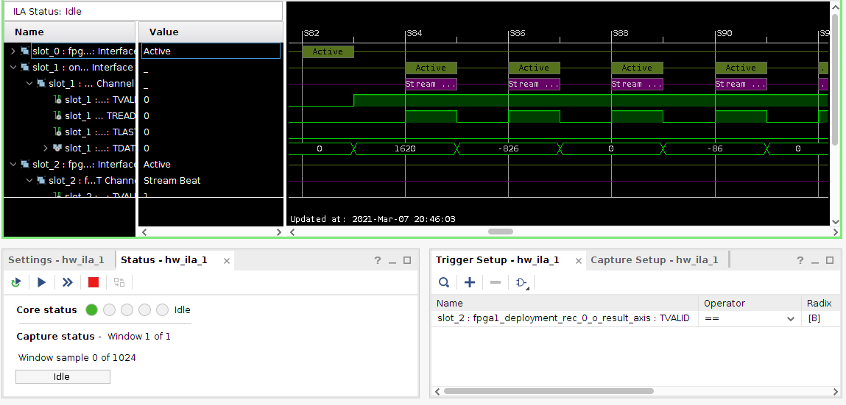
Demo - Compression Algorithm Deployment

Slide 14
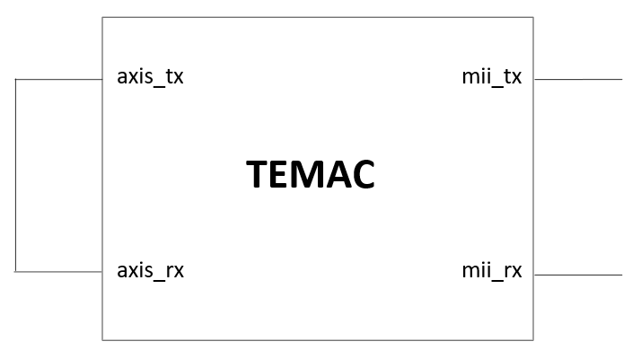
TEMAC (tri-mode ethernet mac)
AXI-stream
PHY
Testbench Monitor
(receives outputs)
Testbench Frame Inputs
Notes:
Bob

Slide 15
Input frames
Five predefined input frames
Frame structure: (Destination address|Source address|Data) <= Valid/Error bit
First frame: Sending data of length 46
Second frame: Sending data of type 8000
Third frame: Sending data containing error bits
Fourth frame: Sending data of length 3
Fifth frame: Sending data of wrong addresses
Notes:
Bob

Slide 16
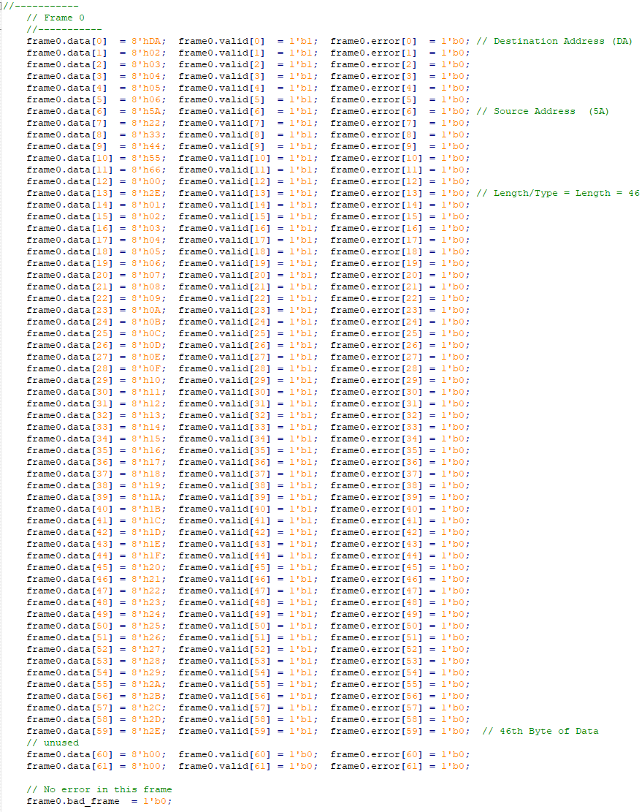
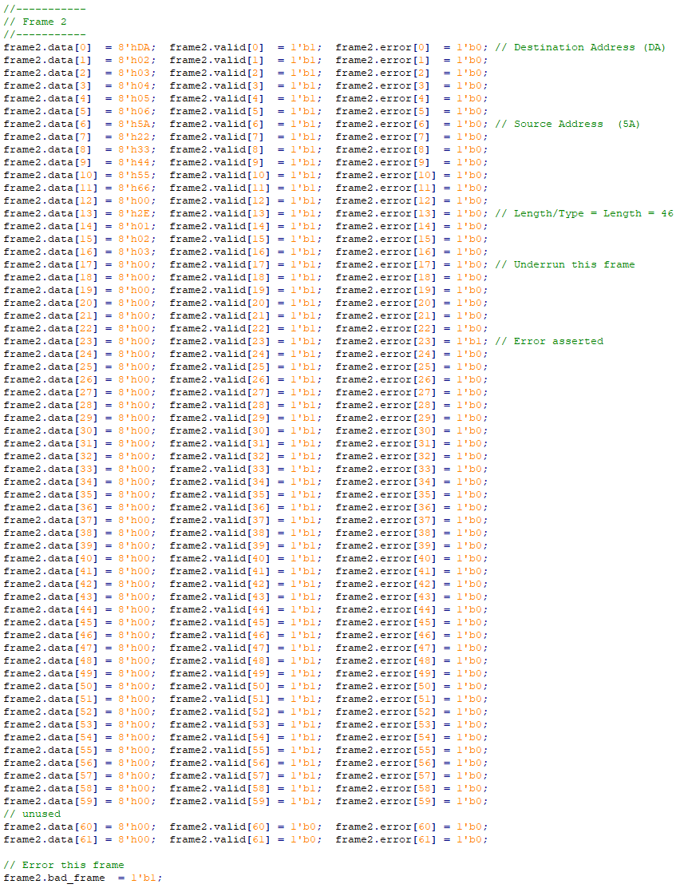
Frame data example
Notes:
Bob

Slide 17
TEMAC testbench results
Blue: frame sent successfully
Red: frames unsent
Notes:
Bob

Slide 18
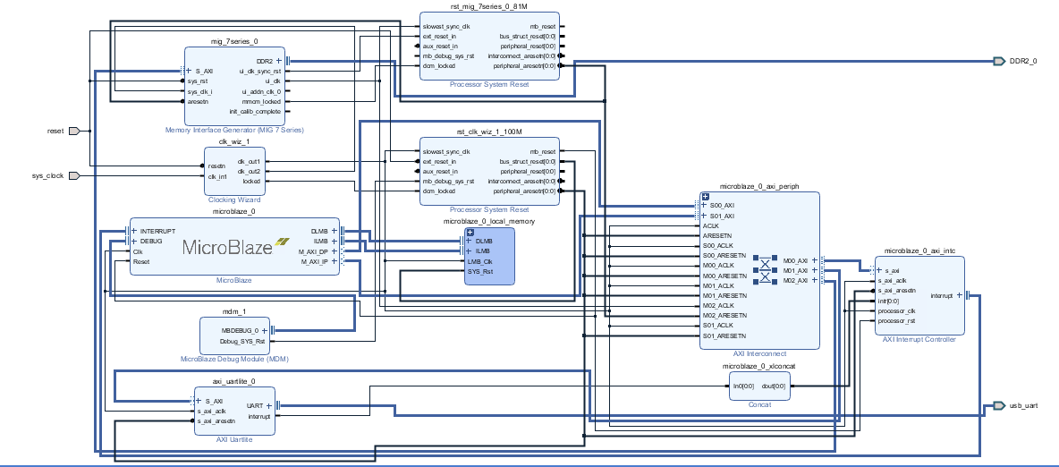
Microblaze Setup
Notes:
Isamu
To input the pixel frames from our Python script, we process the pixel data on the microblaze from the sender and receiver. In order to handle larger amounts of data, we have decided to utilize the DDR memory. This diagram shows the microblaze setup alone

Slide 19
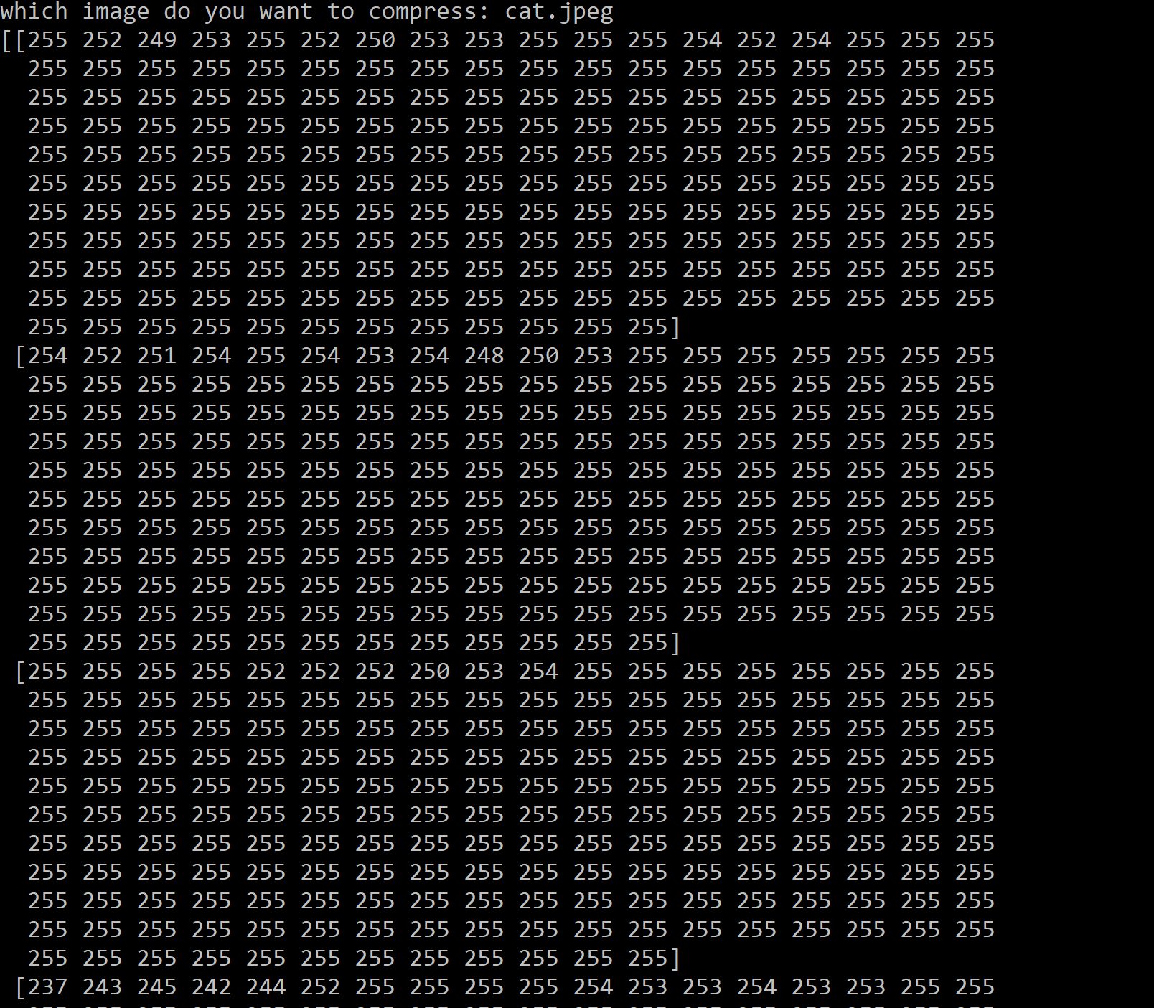


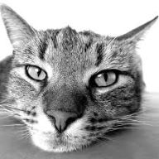
Software I/O
Notes:
Isamu
From the software end, the user inputs an image file which gets converted into an array of pixel values. They are then written onto a text file, and get read by a C program which processes the data. On the decompression end, the flow goes backwards.

Slide 20
Future goals
Compression algorithm:
Implement and test transpose core, Quantizer, Encoder blocks in hardware
Implement Motion Compensation cores on FPGA
Integrate system
Integration on 2 FPGAs
Implement UARTLITE to send pixel values from software to FPGA
Optimizations
Reduce on-chip area of hardware blocks
Improve performance by using DSPs
Implement performance monitoring
Notes:
Isamu

Slide 21
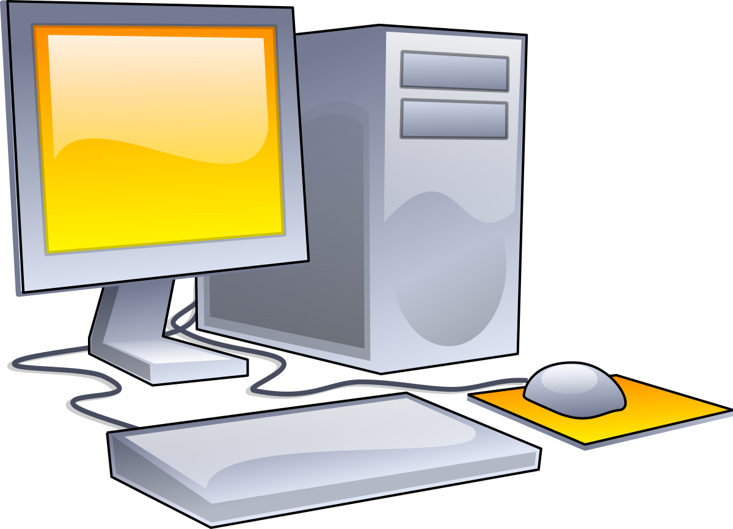
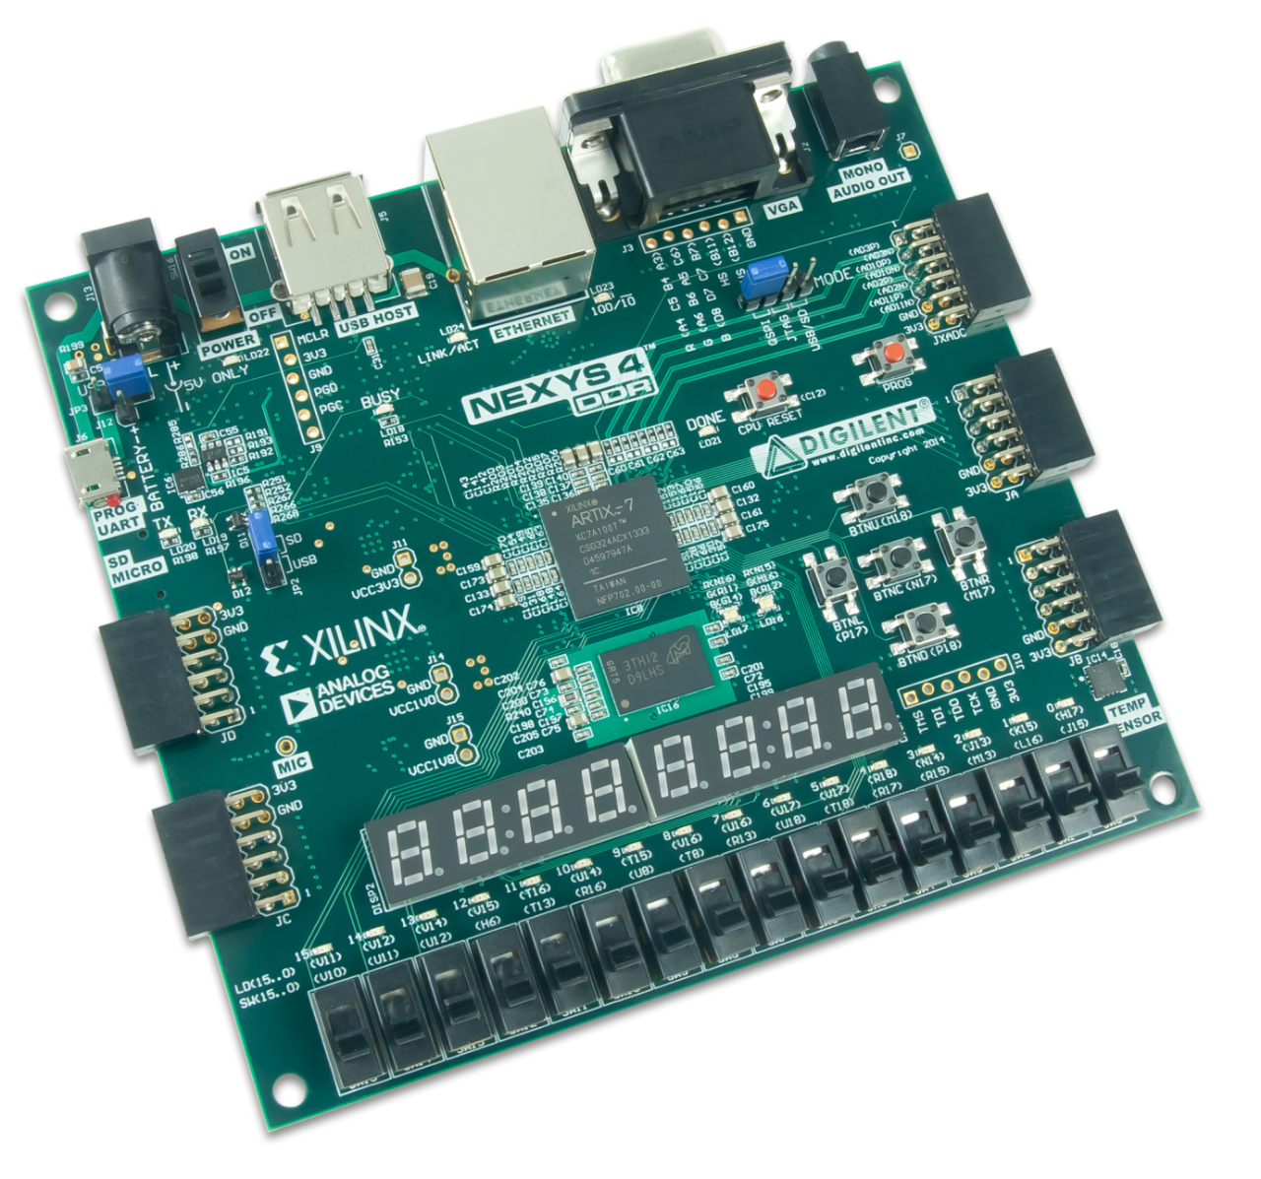
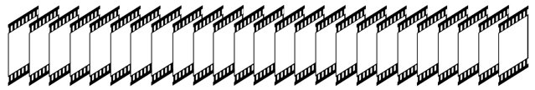
Final demo plan
FPGANet
Notes:
Isamu
GUI on both PC’s to play video frames before and after compression
In case we do not get motion compensation, we will send a stream of compressed video frames to the receiver

Slide 22
Q/A

